Slide 1
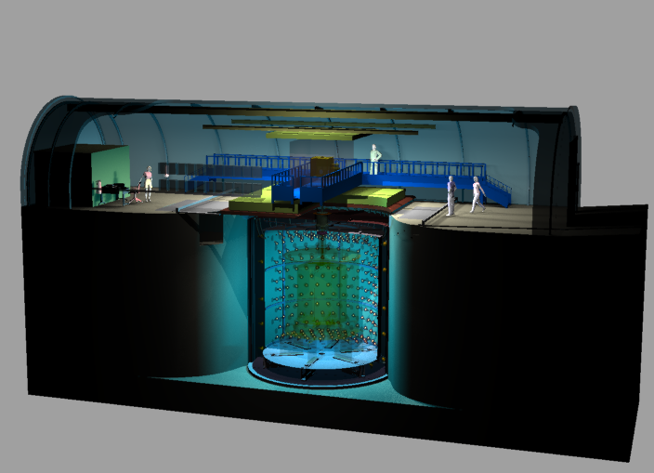
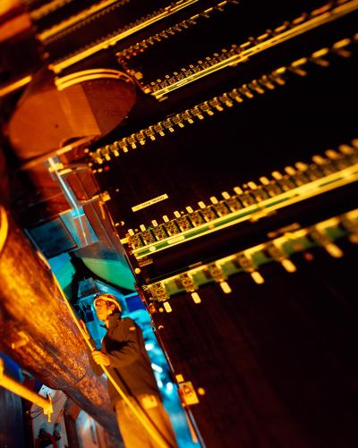
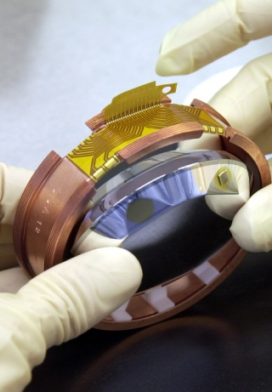
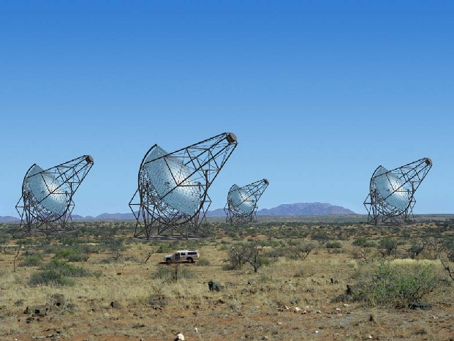
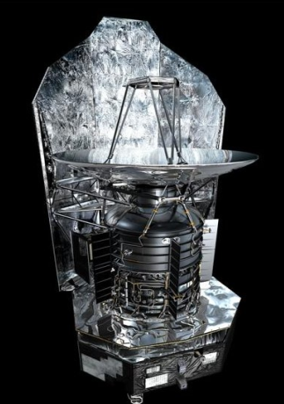
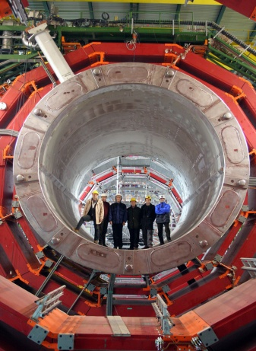


FALL 2014 EPICS Collaboration Meeting
2014 - IRFU
Philippe CHOMAZ
Double Chooz
ALICE
Edelweiss
HESS
Herschel
CMS

Slide 2
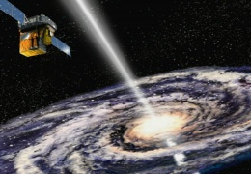
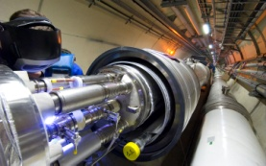
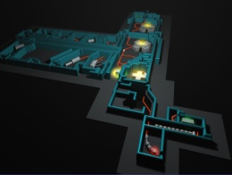
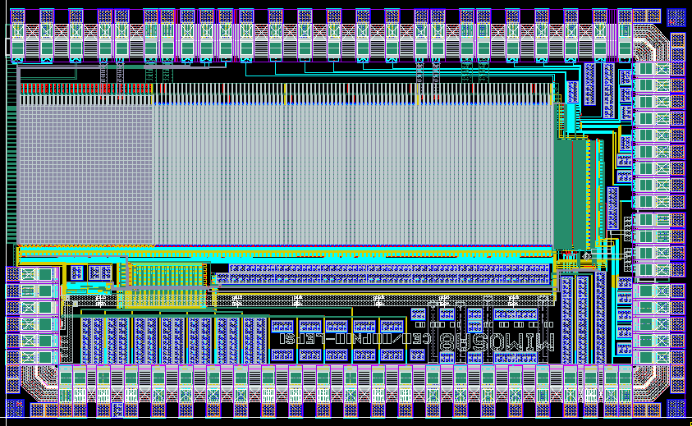

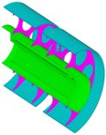
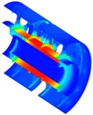
Director: Philippe Chomaz
Assistant: Josiane Parnas
Larsim
Research on sciences matter lab
Etienne Klein
Deputy: Nicolas Alamanos
Marie-Cécile AUBERT
Assistants
Delegates
Quality & Environment Emmanuelle Bougamont
Project Philippe Bourgeois
Communication Sophie Kerhoas-Cavata
Budget Nathalie Judas
Europe Programs Sylvie Leray
Industrial Partnerships Christine Porcheray
Human Resources Christine Tiquet
Continuing education Emmanuelle Bougamont
Computing & Simulation Allan-Sacha Brun
Evaluation Pascal Debu
Safety Alain Le Saux
Computing ressources Michel Mur
PhD Students Jérôme Rodriguez
Scientific Information Angèle Séné
In-kind follow-up Antoine Dael
SAp
Astrophysics and
Space Technologies
Anne Decourchelle
Dep. Head: Michel Talvard
SACM
Accelerators, Cryogenics
and Magnetism
Pierre Védrine
Dep. Head: Philippe Chesny
SPhN
Nuclear Physics
Héloïse Goutte
Dep.Head: Jacques Ball
Sedi
Detectors, Electronics
and Computing
Eric Delagnes
Dep. Head: Philippe Bourgeois
SPP
Particle Physics
Anne-Isabelle Etienvre
Dep. Head: Georges Vasseur
SIS
Mechanical Design
and System Engineering
Florence Ardellier
Dep. Head: Frédéric Molinié

Slide 3



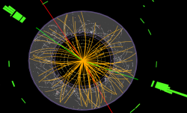
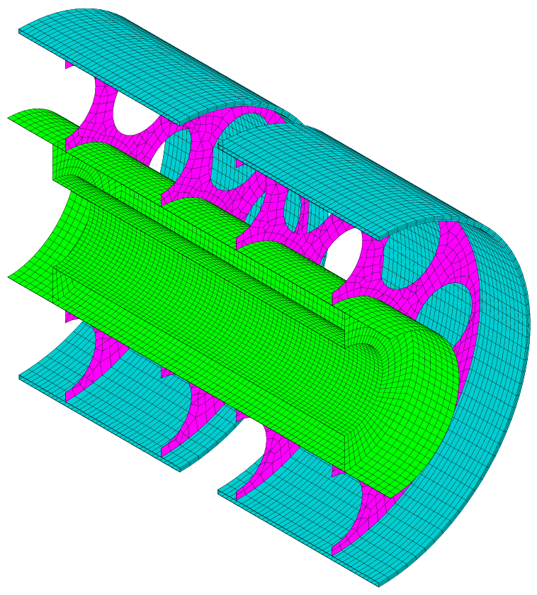
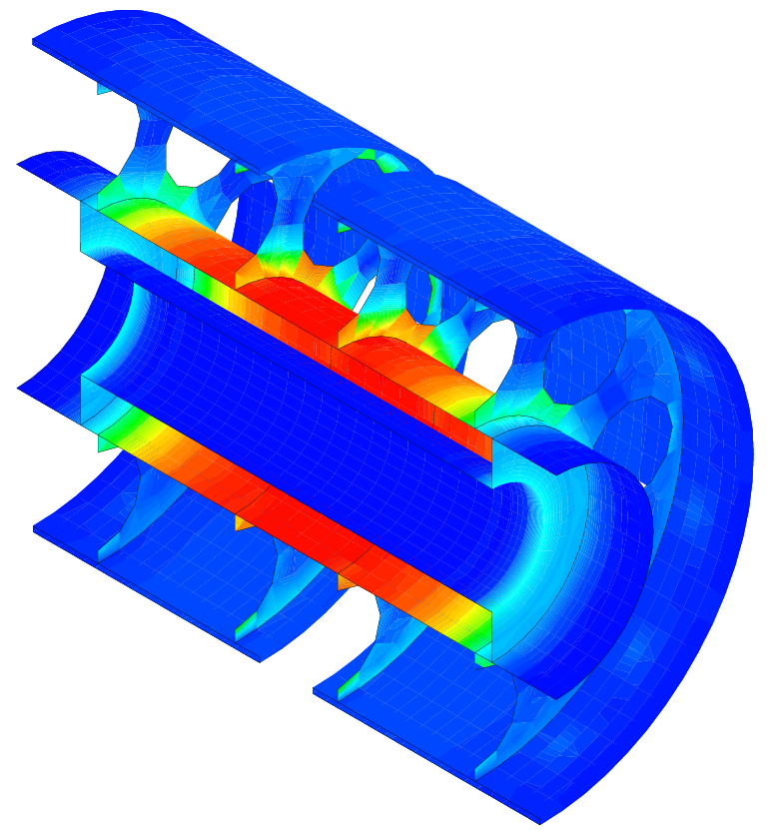
Large CEA Institute created in 1993
Research and Technology
Institute of Research into the Fundamental laws of Universe
Institute of Research into the Fundamental laws of Universe
Astrophysics
Space technologies
116 CDI
94 CDD
Astrophysics
Space technologies
SAp: Astrophysics
Space technologies
Accelerators,
Supra. Magnets
Accelerators,
Supra. Magnets
SACM: Accelerators,
Supra. Magnets
121 CDI
10 CDD
Nuclear Physics
Nuclear Physics
Detectors, electronic,
computing
SPhN: Nuclear Physics
Detectors, electronic,
computing
56 CDI
29 CDD
SEDI: Detectors,
electronic, computing
125 CDI
11 CDD
Particle Physics
Particle Physics
SPP: Particle Physics
Systems engineering
72 CDI
45 CDD
Systems engineering
SIS: Systems engineering
97 CDI
8 CDD

Slide 4
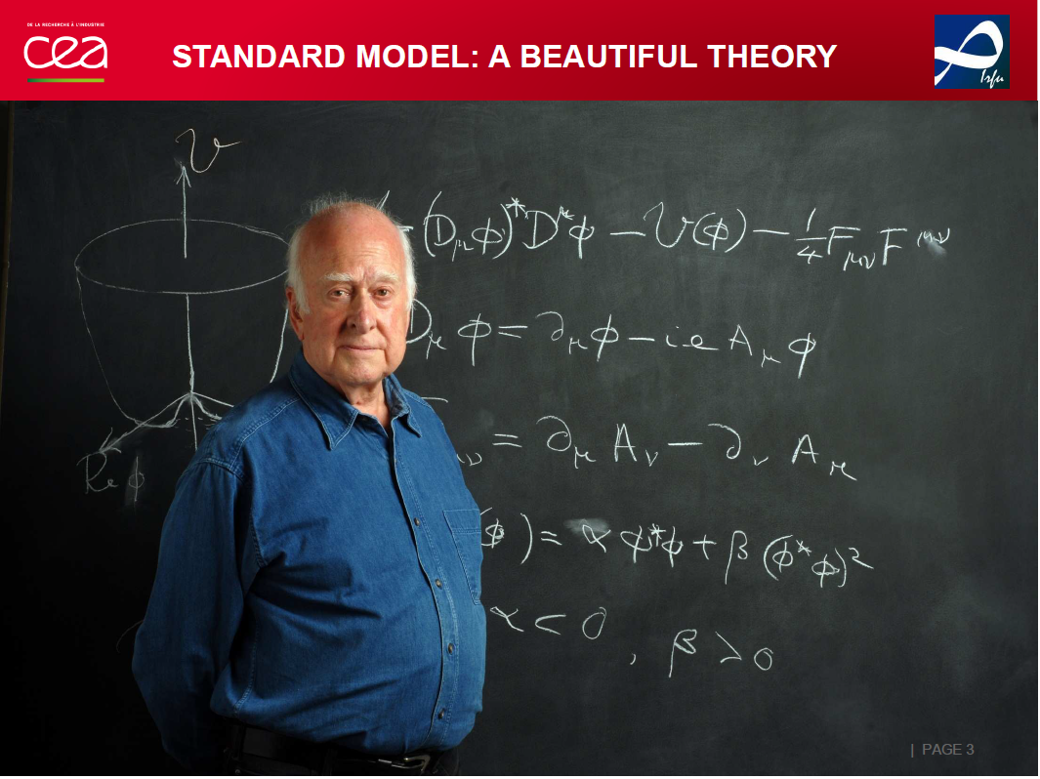
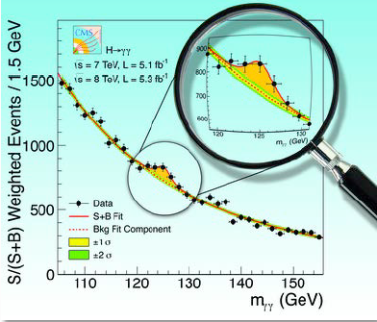

Slide 5
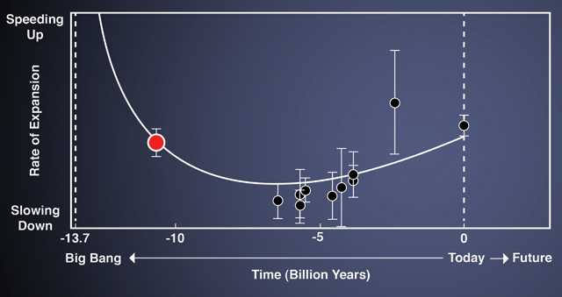
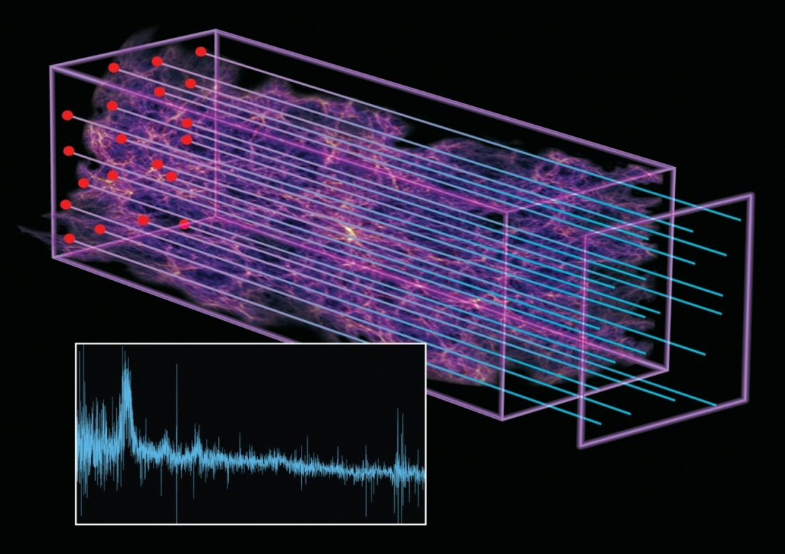
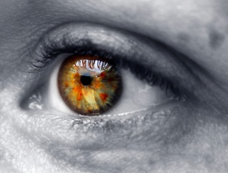
Probing the Intergalactic Medium
First observation of Baryon Acoustic Oscillations (BAO) in intergalactic hydrogen clouds…..
Observation of the deceleration of the expansion
of the Universe 11 billion years ago

Slide 6
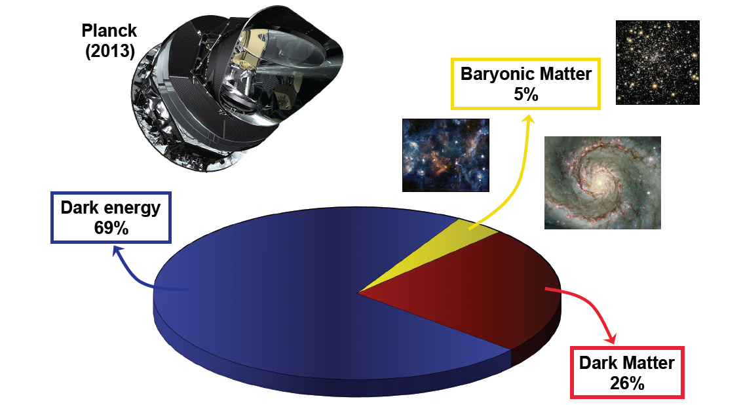
Dark Matter and Neutrino oscillations
Explicit appearance of a neutrino
flavor from neutrinos of
another flavor through neutrino oscillations

Slide 7
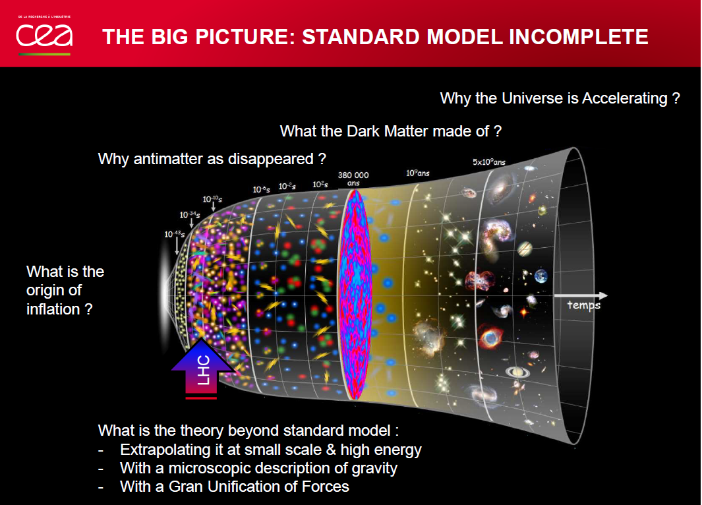

Slide 8
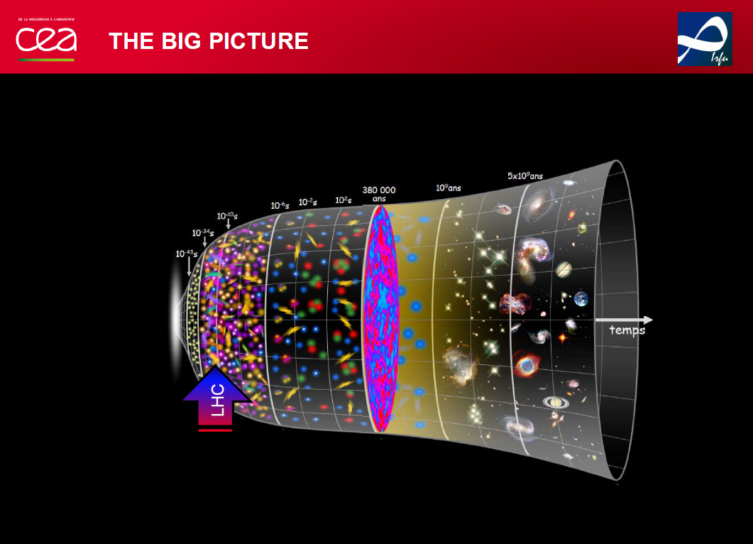
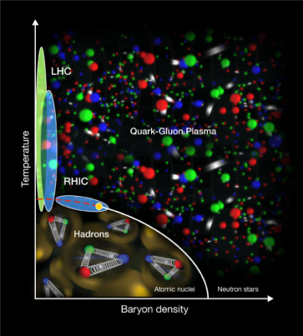
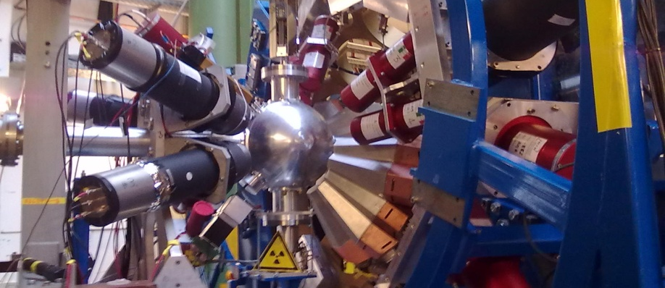
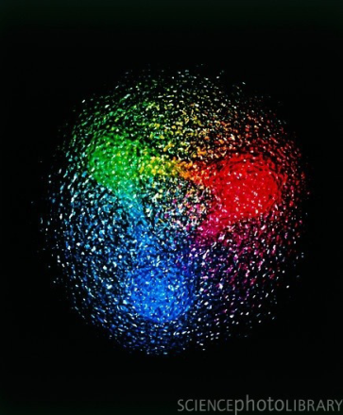

Slide 9
IRFU road maps

Slide 10
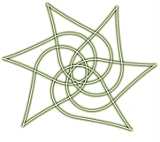


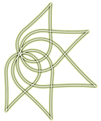
Exploring the fundamental laws of Universe
  Irfu roadmap
Important milestones
2011
2012
2013
2014
2015
2016
2017
2018
2019
2020
Decision
Closing
Ultimate constituents of the universe
Update of
EU strategy
Decision for next generation
Accelerator (ILC, 80KM)
Higgs Discovery
MOU for Upgrades
Upgrades phase 1 operational
Standard model
Atlas - CMS
14 TeV
Atlas – CMS Upgrade
HL - LHC
Measurement of mixing angle
D-Chooz near laboratory
D-Chooz near detector
End of D-Chooz
Decision for Long Baseline
Neutrino physics
T2K
D-Chooz
Long Baseline
Energy content of the universe
Euclid final selection as M2
Planck results on CMB
BAO
Euclid launch 2020
Dark energy
Planck
Update of Direct
DM Detection Strategy
Euclid
Dark matter
Edelweiss
End of Edelweiss measurement at maximum sensitivity
Formation of structures in the universe
Stars and galaxies
Herschel
ArTeMiS
E-ELT Funfing
JWST - MIRI
E-ELT - METIS
JWST Launch
E-ELT First Light → 2024
HE γ astronomy
Hess2
CTA-PP
CTA
CTA First light
SVOM Mission cancelled
SVOM Mission restarted by CNES
Athena+
Violent universe
SVOM
SVOM
ν Astronomy
KM3
Withdrawal of KM3 Collaboration
Structures of nuclear matter
Exotic nuclei
Funding of S³ Equipex
SPII – Phase 1 First beam
SPII – Phase 2 First beam
Agata - demo
S³ Experiment
Agata-1Π Spiral2
Spiral2 Phase 2
Heavy ions physics run
MOU for Detectors Upgrades
Upgrades operational
Quarks Gluons Plasma
Alice
Alice Upgrade
Quark Gluon Structure
SPSC Compass II Selection
Compass II
Start of Compass physics run
CLAS12 physics run
CLAS 12GeV
End of Compas II measurement of GPD
Electron-Ion

Slide 11


Inventing and constructing new devices
Cryotechnologies
  Irfu roadmap in Cryotechnologies
Important milestones
2011
2012
2013
2014
2015
2016
2017
2018
2019
2020
Expected decision
Superconducting Magnets
ISEULT Magnet
Start of magnet production
ISEULT
Start of commissioning at Neurospin
Gradiens Coils
R3B Glad
Test in W7X cryostat
MOU CEA-FAIR
Installation of R3B magnet at GSI
Delivery of Super FRS dipoles at GSI
GSI - Fair Magnets
Super FRS dipoles
LHC Insert Magnets
Eucard 2 FP7 and CEF
LHC Upgrade
HL - LHC
HE - LHC
Cryogenic Tests Facilities
Coil Test Facilities
JT60 SA
End of CTF construction
End of JT60 Coil Tests
ITER - Activities
Sources and Injectors
Installation RFQ at CERN
MOU CEA-FAIR
Delivery at GSI
Protons Injectors
LINAC4
FAIR p-Linac
Deuterons Sources
& Injectors
1st beam at Saclay
First beam at Ganil
Decision on SARAF
End of Saraf study
1st beam at Rokkasho
Installation at Soreq
Decision
SPIRAL2
IFMIF-EVEDA
SARAF
IFMIF
End of RFQ reception
ESS TDR
Decision on ESS
End of IPHI Tests
ESS RFQ
High intensity Injectors
IPHI
Superconducting LINACS
Protons-Deuterons
SC Linacs
Validation of SRF-Linac concept
Decision on SARAF
Start SRF-Linac integration
Start of commissioning at Rokkasho
Start delivery at Lund
IFMIF-EVEDA SRF-Linac
ESS / SARAF Cryomodule
XFEL Convention signed
Start of industrial production
End of industrial production
Electrons Cryomodules
E-XFEL
ILC

Slide 12
Participating in the construction of SPIRAL2

Slide 13
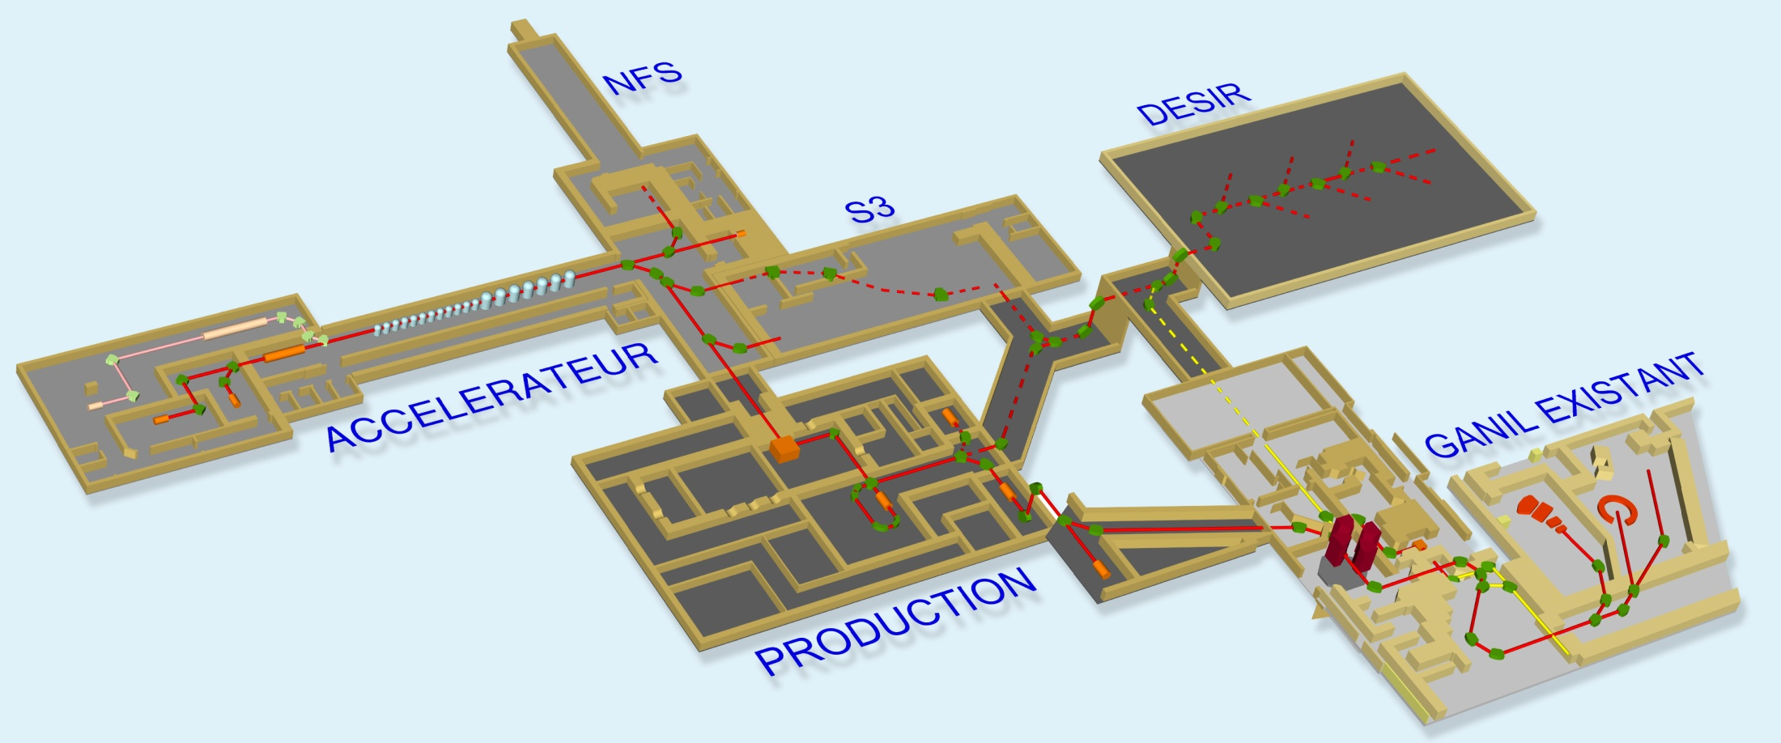
SPIRAL 2
Construction of the accelerator in two phases
Phase 1
Linear Accelerator
Experimental Halls
Phase 2
Exotic beams production
DESIR

Slide 14
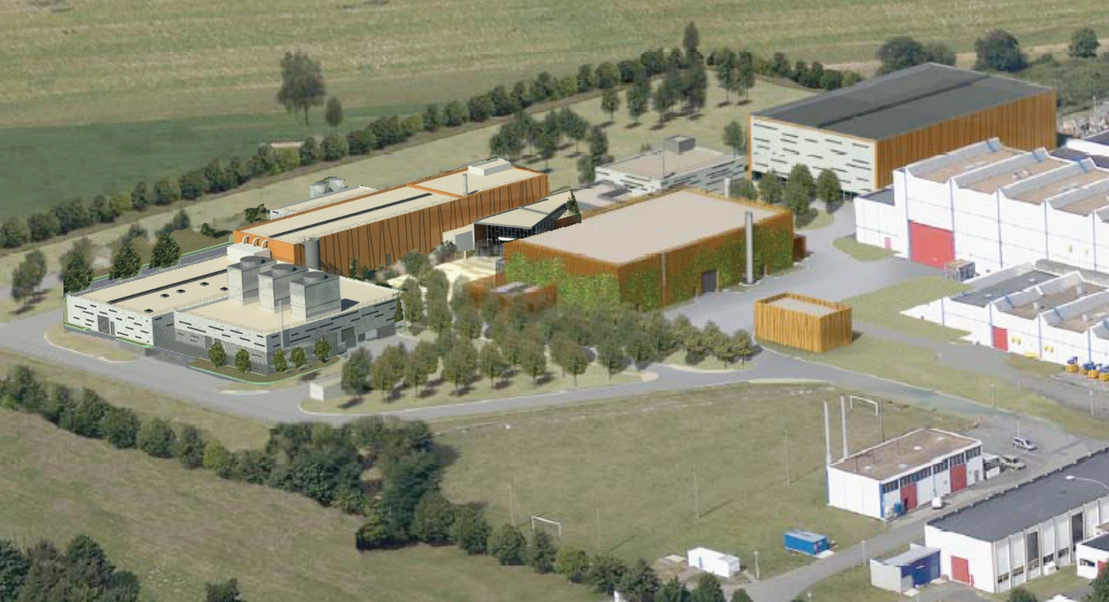
LINAC
C
C
Existing GANIL
Radioactive beams production building

Slide 15
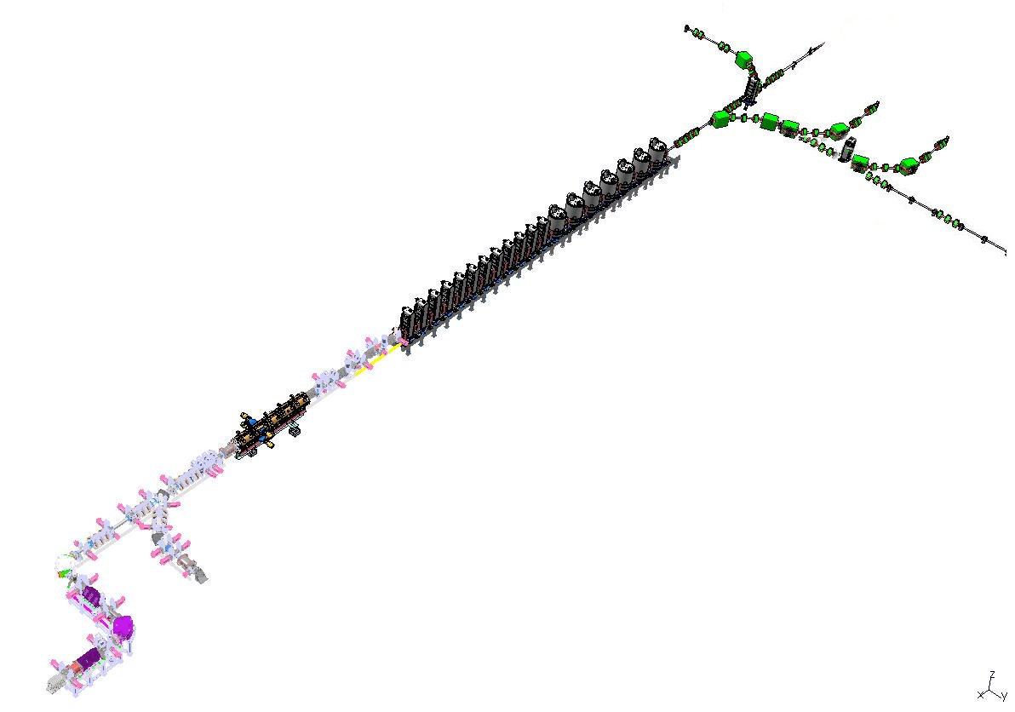
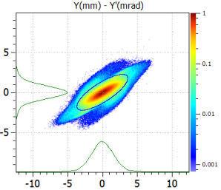
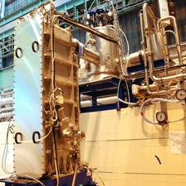
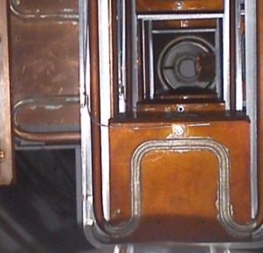
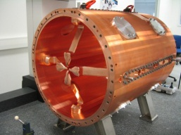
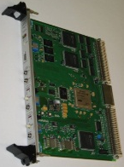
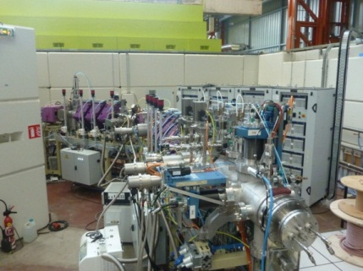
The Irfu workpakages for the accelerator
Beam dynamics studies
MEBT slits
β=0.07 « A »
cryomodules
RFQ
LEBT
Low Level RF electronics
deuterons/protons source, Mechanics integration, slits, CC, instrumentation / automatisms, integration and tests of LEBT2 - LEBTC
Mechanics integration, slits, CC, instrumentation / automatisms LEBT1

Slide 16
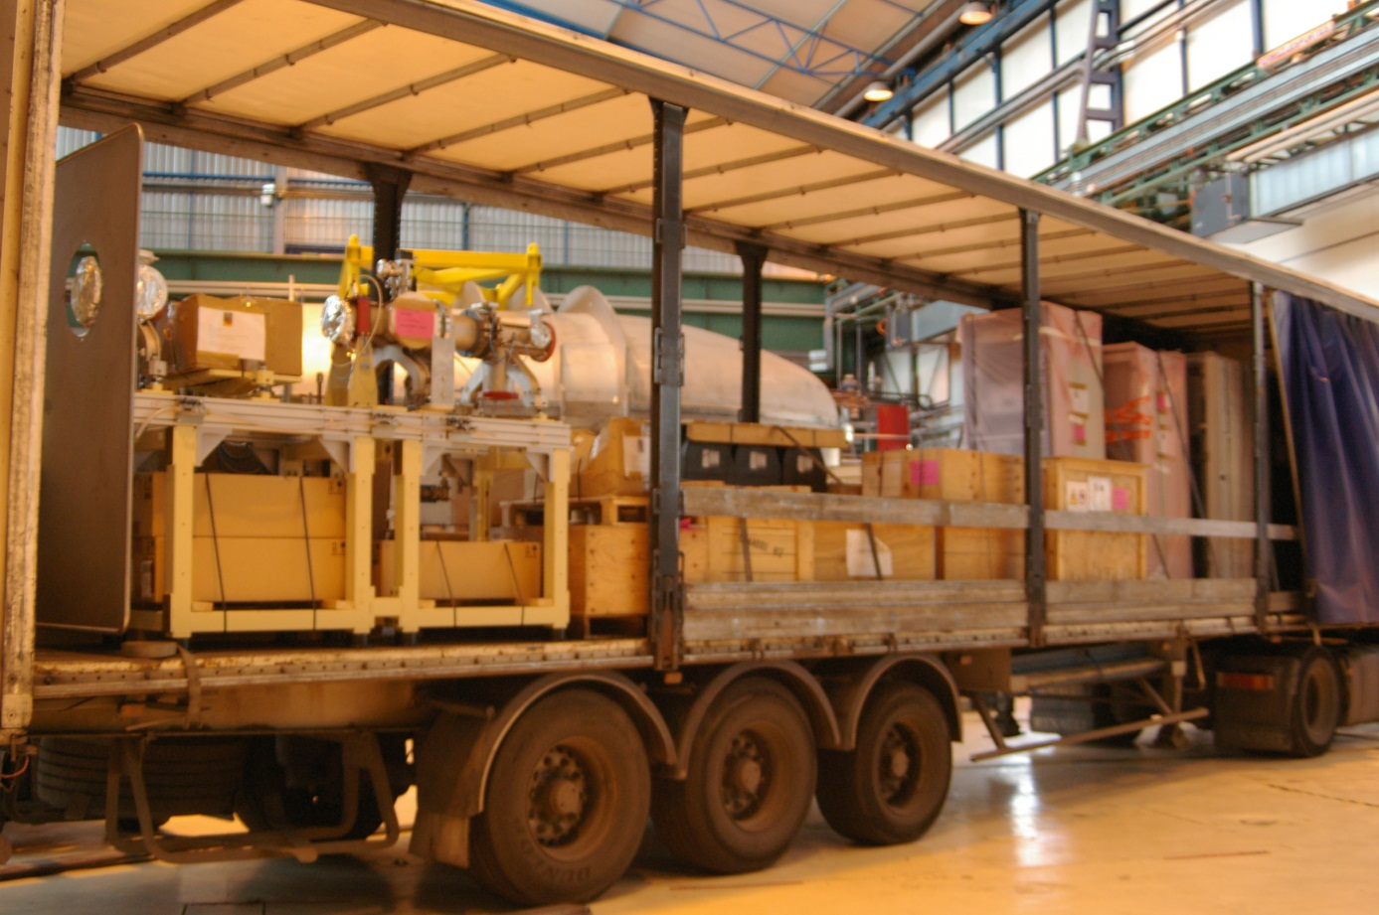
Livraison de l’injecteur SPIRAL 2

Slide 17
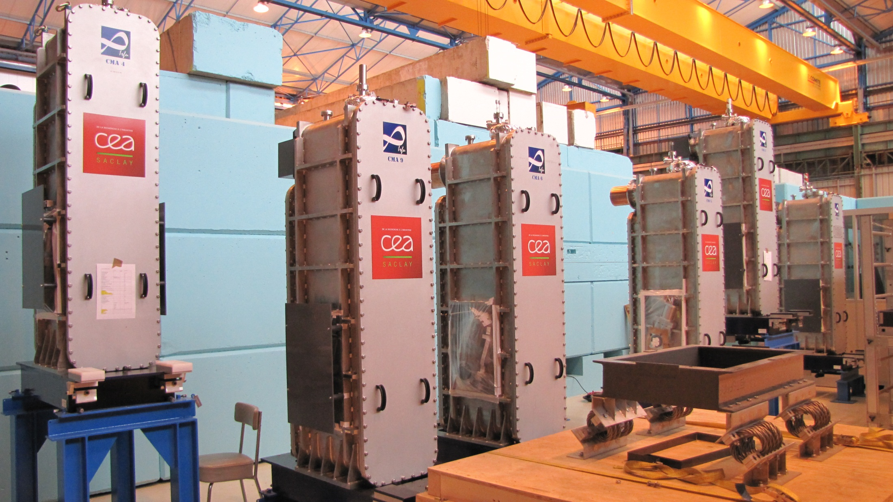

Slide 18
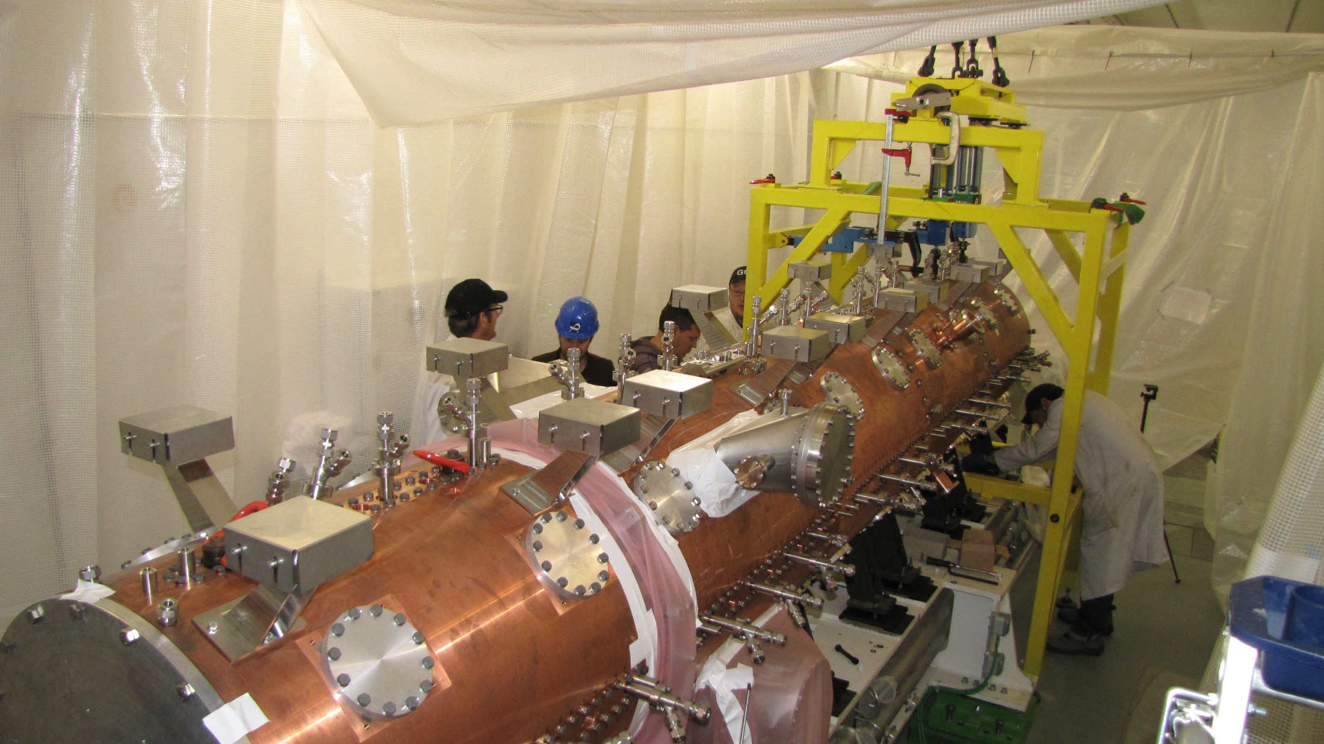

Slide 19
Participation in the construction of accelerators in Europe

Slide 20
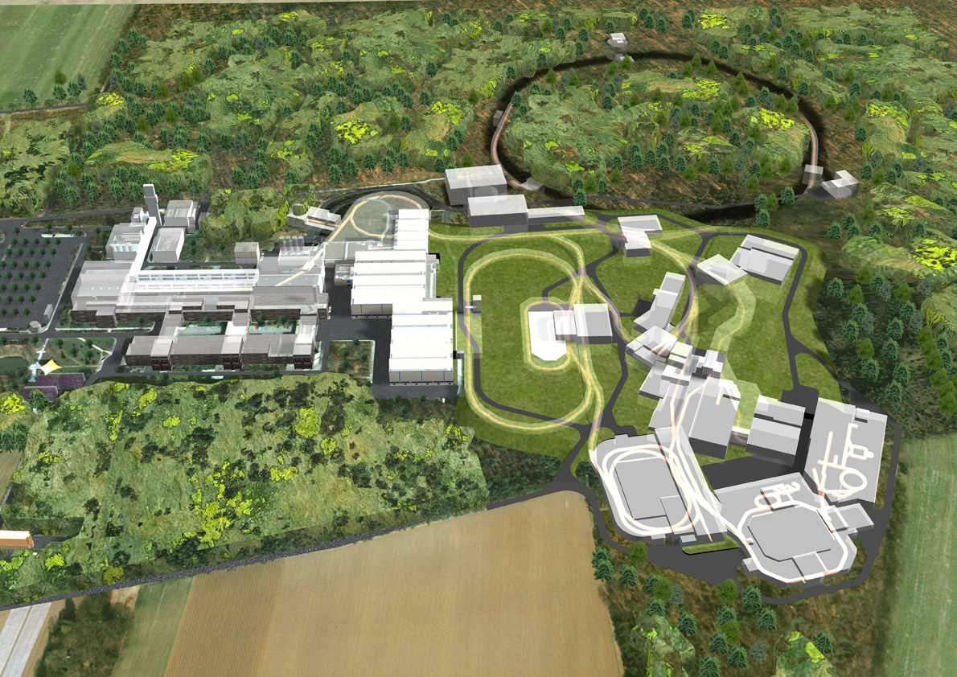
FAIR

Slide 21
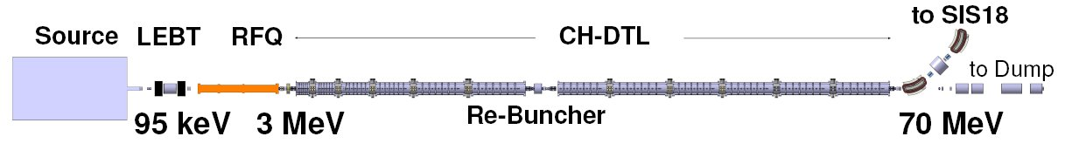

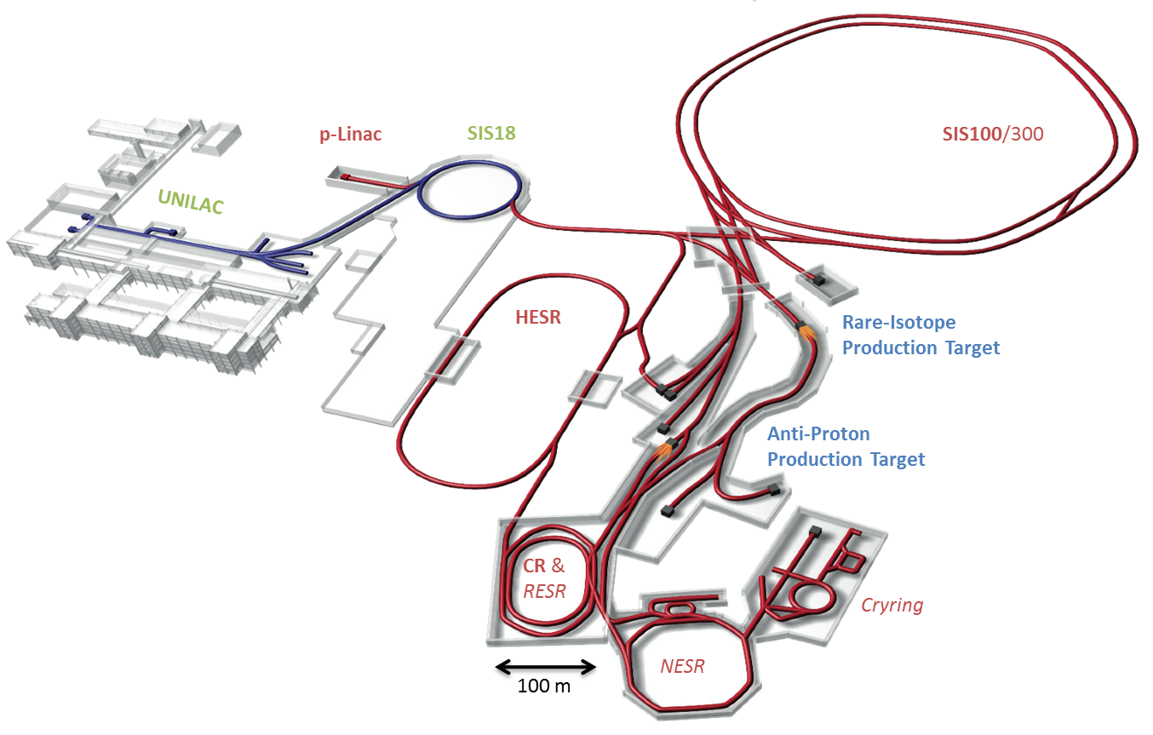


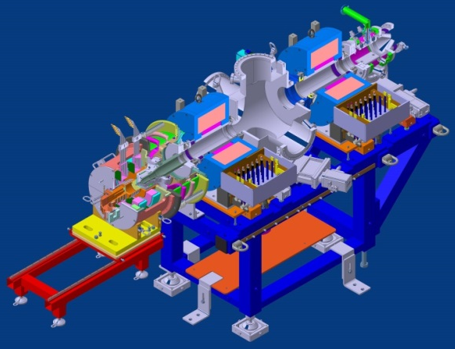
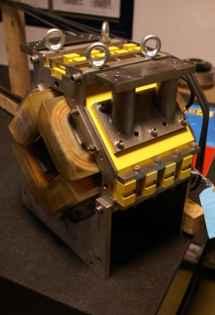


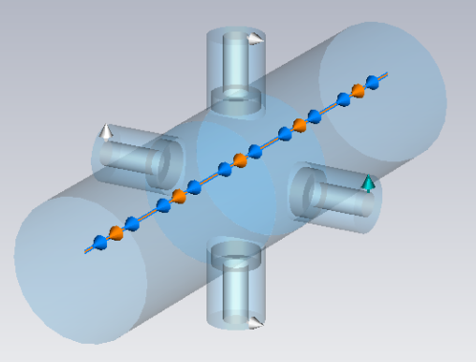
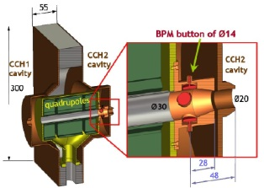
FAIR proton Linac
Beam Energy | 70 MeV
Beam Current (op.) | 35 mA
Beam current (des.) | 70 mA
Beam pulse length | 36 µs
Repetition rate | 4 Hz
RF-Frequency | 325.224 MHz
Total hor. emittance (norm) | 2.1/4.2 µm
Tot. Mom. spread | ≤ ±10⁻³
Linac length | ≈ 35 m
“Cooperation Agreement on the French contribution to the construction of the international Facility for Antiproton and Ion Research in Europe (FAIR)
and on the German contribution to the construction of the SPIRAL2 Facility at GANIL”
GSI, Frankfurt University, CEA, CNRS, GANIL
Implication of Irfu in 3 WP for the p-Linac Period 2009-2017
WP5 External Magnets
WP1 Source & LEBT
Présentation générale
WP7 Diagnostics BPM

Slide 22
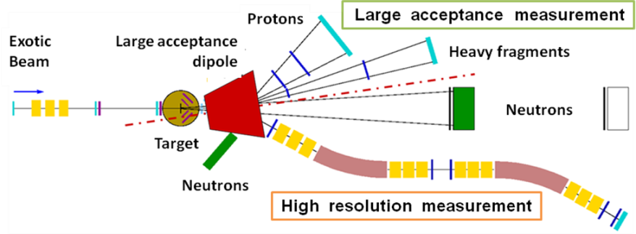
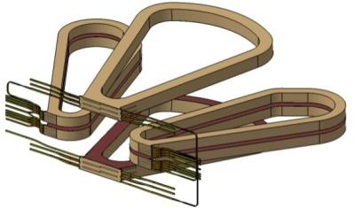
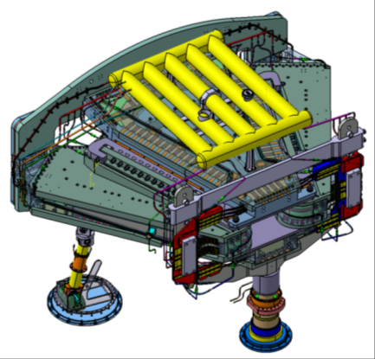

R3B-Glad
R3B-Glad
1 GeV / A
GSI
FAIR
B
l
Structure innovante
Aimant à blindage actif et refroidissement indirect par thermosiphon
Effort entre bobines principales : 500 tonnes

Slide 23

R3B-Glad

Slide 24





French contribution to XFEL
Irfu (Saclay) : Integration of 83 (100) cryomodules
  Cryomodules integrated in a new dedicated facility
  Assembly in clean room of 83 cavity strings
  Assembly of 83 cold masses in their vacuum vessel
  Series operation sub-contracted to an industrial operator (ALSYOM, ALCEN group)
IN2P3/LAL (Orsay) : Delivery of over 650 (800) Couplers
  LAL hosts all the conditionning process
  Contract attributed to a Thales / RI consortium
  Couplers received, prepared, conditionned & sent for integration in the cryomodules
Couplers industrialization (Orsay)

Slide 25



Integration of XFEL cryomodules (Saclay)
Each cavity string contains 8 cavities, 8 RF couplers , one quadrupole, one BPM and two vacuum valves
Transfer of cryomodule in clean room roll-out area
Transfer of cryomodule in RF coupler assembly area

Slide 26



Involvement of IRFU and IN2P3 in ESS
ESS elliptical cryomodules

Slide 27
Involvement of IRFU and IN2P3 in ESS
France is « financing »
~8% of the project
CEA contribution of the
Order of ~90M€

Slide 28


Slide 29
Participation in the construction of accelerators in Japan

Slide 30






Involvement of CEA Saclay in IFMIF-EVEDA
IFMIF Accelerator
IFMIF-EVEDA Prototype Accelerator

Slide 31

Projet IFMIF :
World record for the deuterons injector
140 mA at 100 keV (14 kW)

Slide 32
Projet Saraf:

Slide 33
I would like to wish you an
exciting and fruitful meeting

Slide 34
















Irfu

Slide 35
Irfu

